Slide 1
CS3223 Tutorial 1
27 Jan 2022 (Courtesy of Sean)

Slide 2
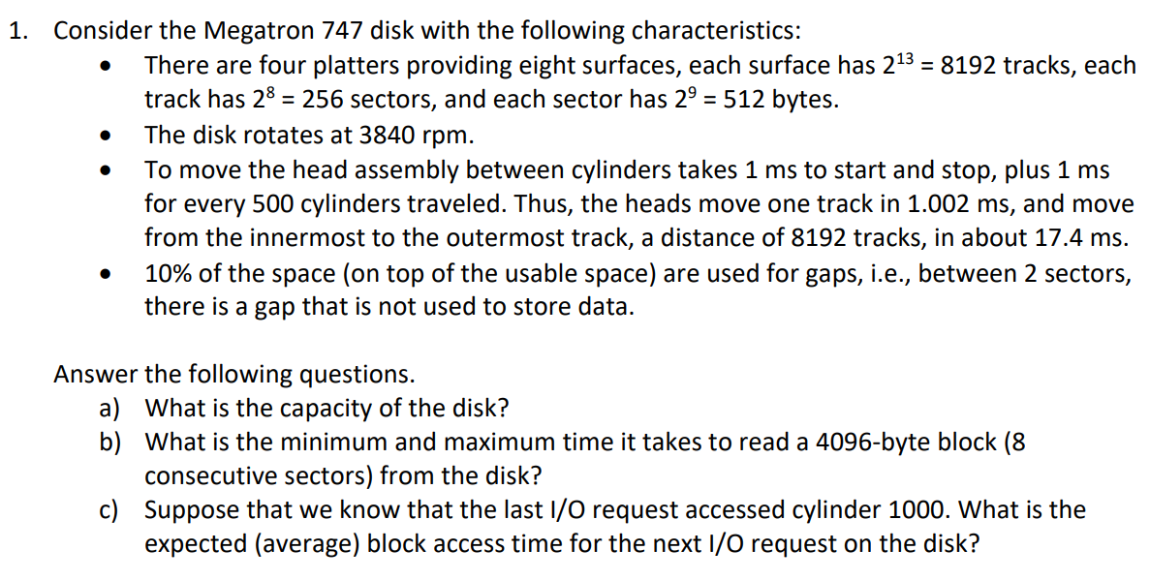
Question 1

Slide 3
Question 1(a)

Slide 4
Question 1(a)
1 Sector = 2⁹ bytes 1 Track = 2⁹ * 2⁸ = 2¹⁷ bytes 1 Surface = 2¹⁷ * 2¹³ = 2³⁰ bytes 1 Disk = 4 Platters = 2³⁰ * 8 = 2³³ bytes

Slide 5
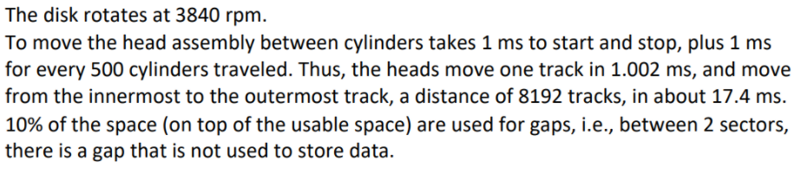
Question 1(b)

Slide 6
Question 1(b)
Rotational Time = 60 / 3840 = 0.015625s = 15.625ms
Rotational Time for Sector + Gap = 15.625 / 256 = 0.061ms
Rotational Time for Sector (W/O Gap) = 0.061 * 0.9 = 0.055ms

Slide 7
Question 1(b)
Transfer Time to transfer 8 sectors + 7 gaps = 7 * 0.061 + 0.055 = 0.482ms
Min Time = 0ms + 0ms + 0.482ms = 0.482ms
Max Time = 17.4ms + 15.625ms + 0.482ms = 33.507ms
(Calculated using Seek Time + Rotational Delay + Transfer Time)

Slide 8
Question 1(c)

Slide 9
Question 1(c)
Average number of cylinders travelled = (999+998+...+1+0)/8192 +(1+...+7192)/8192 = 3218.45
Average Seek Time = 1 + 1 * (3218.45/500) = 7.44ms
Average Rotational Delay = 15.625/2 = 7.8125ms
Total I/O TIme = 7.44 + 7.8125 + 0.482 = 15.73ms
Note: On average, it takes about half a rotation for the correct sector to come under the head.

Slide 10
Question 1
Learning Objective:
Understand how disk storage works on a simplified level
Understand the concepts of seek time, rotational delay and transfer time and how they play a part in I/O cost

Slide 11
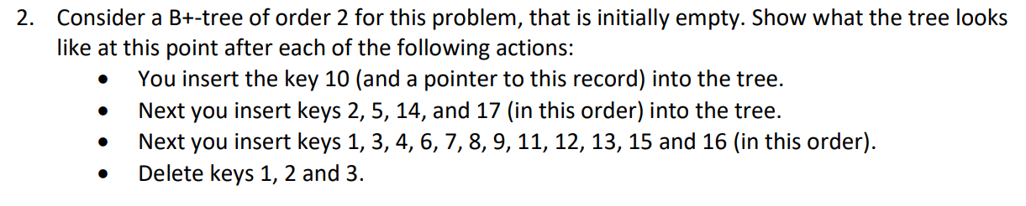
Question 2

Slide 12
Question 2
10
Insert: 10

Slide 13
Question 2
2
5
10
14
Insert: 2, 5, 14

Slide 14
Question 2
2
5
10
14
17
Overflow
Insert: 2, 5, 14, 17

Slide 15
Question 2
10
Overflow
2
5
10
14
17
Insert: 2, 5, 14, 17

Slide 16
Question 2
10
2
5
10
14
17
Insert: 2, 5, 14, 17

Slide 17
Question 2
10
1
2
3
5
10
14
17
Insert: 1, 3

Slide 18
Question 2
10
1
2
3
4
5
10
14
17
Overflow
Insert: 1, 3, 4

Slide 19
Question 2
3
10
1
2
3
4
5
10
14
17
Insert: 1, 3, 4

Slide 20
Question 2
3
5
10
1
2
3
4
5
6
7
10
14
17
Insert: 1, 3, 4, 6, 7

Slide 21
Question 2
3
5
7
10
1
2
3
4
5
6
7
8
9
10
11
14
17
Insert: 1, 3, 4, 6, 7, 8, 9, 11

Slide 22
Question 2
3
5
7
10
1
2
3
4
5
6
7
8
9
10
11
12
14
17
Overflow
Insert: 1, 3, 4, 6, 7, 8, 9, 11, 12

Slide 23
Question 2
Overflow
3
5
7
10
12
1
2
3
4
5
6
7
8
9
10
11
12
14
17
Insert: 1, 3, 4, 6, 7, 8, 9, 11, 12

Slide 24
Question 2
7
Overflow
3
5
10
12
1
2
3
4
5
6
7
8
9
10
11
12
14
17
Insert: 1, 3, 4, 6, 7, 8, 9, 11, 12

Slide 25
Question 2
7
3
5
10
12
1
2
3
4
5
6
7
8
9
10
11
12
14
17
Insert: 1, 3, 4, 6, 7, 8, 9, 11, 12

Slide 26
Question 2
7
3
5
10
12
14
3
4
5
6
7
8
9
10
11
14
14
15
16
17
12
15
1
2
13
Insert: 1, 3, 4, 6, 7, 8, 9, 11, 12, 13, 15, 16

Slide 27
Question 2
7
3
5
10
12
14
Underflow
3
4
5
6
7
8
9
10
11
14
14
15
16
17
12
15
2
13
Delete: 1

Slide 28
Question 2
7
Underflow
5
10
12
14
2
3
4
5
6
7
8
9
10
11
14
14
15
16
17
12
15
13
Delete: 1

Slide 29
Question 2
Underflow
5
7
10
12
14
2
3
4
5
6
7
8
9
10
11
14
14
15
16
17
12
15
13
Delete: 1

Slide 30
Question 2
10
5
7
12
14
2
3
4
5
6
7
8
9
10
11
14
14
15
16
17
12
15
13
Delete: 1

Slide 31
Question 2
10
5
7
12
14
14
15
17
3
4
5
6
7
8
9
10
11
14
16
17
12
15
13
Delete: 1, 2

Slide 32
Question 2
10
5
7
12
14
Underflow
14
15
17
4
5
6
7
8
9
10
11
14
16
17
12
15
13
Delete: 1, 2, 3

Slide 33
Question 2
10
Underflow
7
12
14
14
15
17
4
5
6
7
8
9
10
11
14
16
17
12
15
13
Delete: 1, 2, 3

Slide 34
Question 2
Underflow
7
10
12
14
14
15
17
4
5
6
7
8
9
10
11
14
16
17
12
15
13
Delete: 1, 2, 3

Slide 35
Question 2
7
10
12
14
14
15
17
4
5
6
7
8
9
10
11
12
13
16
17
Delete: 1, 2, 3

Slide 36
Question 2
Learning Objective:
Understand how the Insertion and Deletion algorithms of the B+ Tree Data Structure
Understand the conditions and the solutions to underflow / overflow of nodes

Slide 37
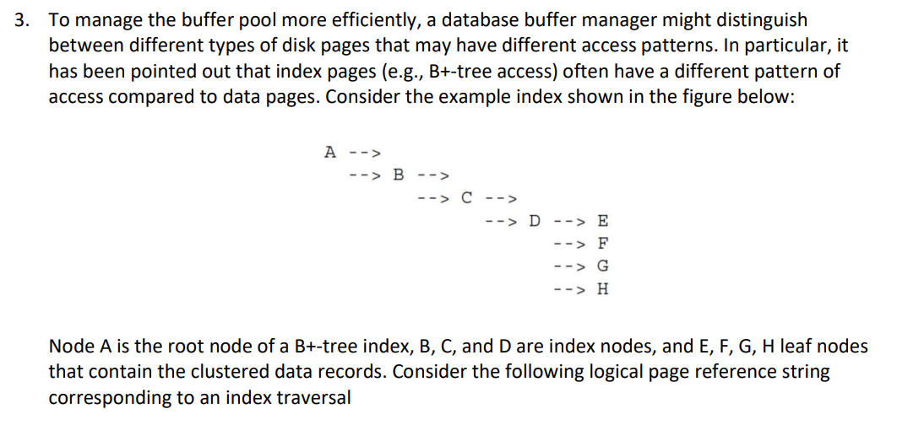
Question 3

Slide 38
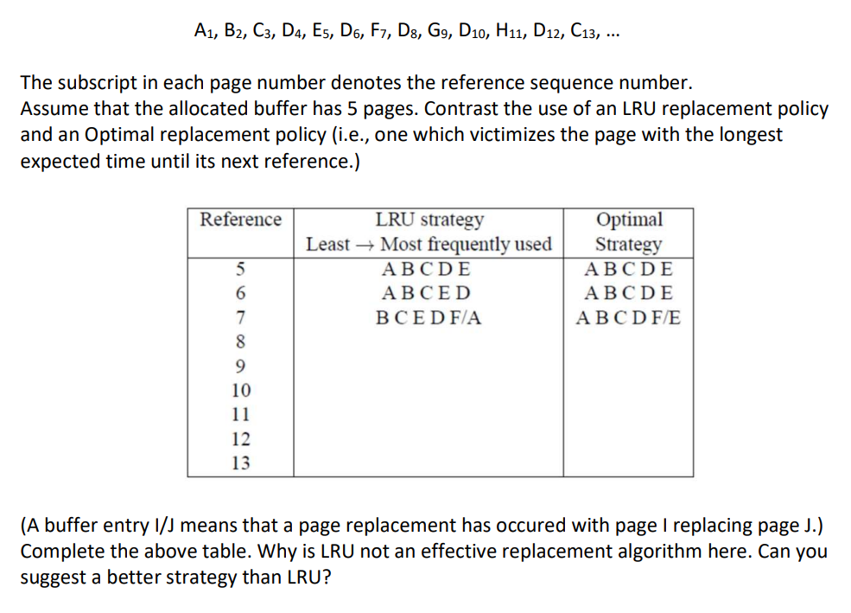
Question 3

Slide 39

Question 3
Ref | LRU | Changes | Optimal | Changes
5 | A B C D E | 0 | A B C D E | 0
6 | A B C E D | 0 | A B C D E | 0
7 | B C D E F/ A | 1 | A B C D F / E | 1
8 | B C E F D | 1 | A B C D F | 1
9 | C E F D G / B | 2 | A B C D G / F | 2
10 | C E F G D | 2 | A B C D G | 2
11 | E F G D H / C | 3 | A B C D H / G | 3
12 | E F G H D | 3 | A B C D H | 3
13 | F G H D C / E | 4 | A N C D H | 3

Slide 40
Question 3
Ref | MRU | Changes | Optimal | Changes
5 | A B C D E | 0 | A B C D E | 0
6 | A B C E D | 0 | A B C D E | 0
7 | A B C E F / D | 1 | A B C D F / E | 1
8 | A B C E D / F | 2 | A B C D F | 1

Slide 41
Question 3
Possible Solutions?
Replace based on the level of the B+ Tree by allocating buffer for leaf nodes and non-leaf nodes

Slide 42
Question 3
Learning Objective:
No Single Buffer replacement strategy will work best (incomplete information of future transactions)

